Slide 1

Journalists Killed Since 1992
Data Analysis using python by kimaya shringarpure and simran s Chikkala

Slide 2
Introduction
The state of press freedom serves as a parameter to check the health of democracies and human rights. Unfortunately, journalists are often caught up in the crossfire between the truth and forces that seek to suppress it. The Committee to Protect Journalists (CPJ) has been meticulously documenting the tragedies and the fatalities faced by journalists since 1992. The dataset provided by the CPJ documents the circumstances surrounding journalist deaths and providing a raw account of the dangers inherent in the profession of investigative journalism since 1992. Through EDA using Python, we have extracted meaningful insights and identified trends to contribute to a deeper understanding of the risks journalists face in different regions and under varied circumstances.

Slide 3
Objectives
To identify the statistical features of the chosen dataset
To find patterns and trends in the dataset and derive insights and conclusions on relevant topics
To perform EDA using methods of libraries like pandas and matplotlib of python as learnt in class

Slide 4
Dataset Description
Dimensions of the CPJ Dataset: (1253, 17)
Size of the CPJ Dataset: 21301
Data columns (total 17 columns):
# Column Non-Null Count Dtype
--- ------ -------------- -----
0 Date 1218 non-null datetime64[ns]
1 Name 1253 non-null object
2 Sex 1253 non-null object
3 Country Killed 1253 non-null object
4 Organization 1253 non-null object
5 Nationality 1253 non-null object
6 Medium 1253 non-null object
7 Job 1253 non-null object
8 Coverage 1253 non-null object
9 Freelance 1253 non-null object
10 Local/Foreign 1253 non-null object
11 Source of Fire 1253 non-null object
12 Type of Death 1253 non-null object
13 Impunity (for Murder) 1253 non-null object
14 Taken Captive 1253 non-null object
15 Threatened 1253 non-null object
16 Tortured 1253 non-null object
dtypes: datetime64[ns](1), object(16)

Slide 5
Data Cleaning
Removing redundant columns
Removing null values
Filling null values with median to keep consistency of data

Slide 6
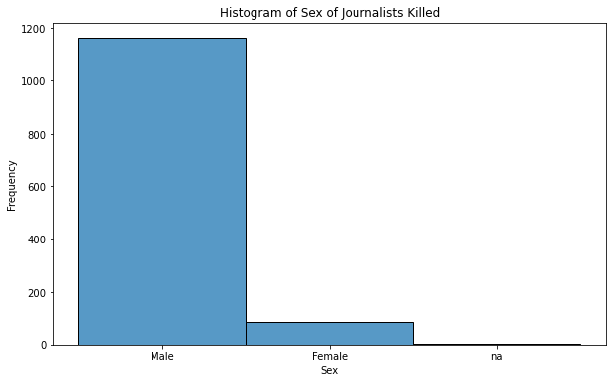
Data Analysis and Visualisations
Based on Sex
Count
Female 88
Male 1162
na 3
dtype: int64

Slide 7
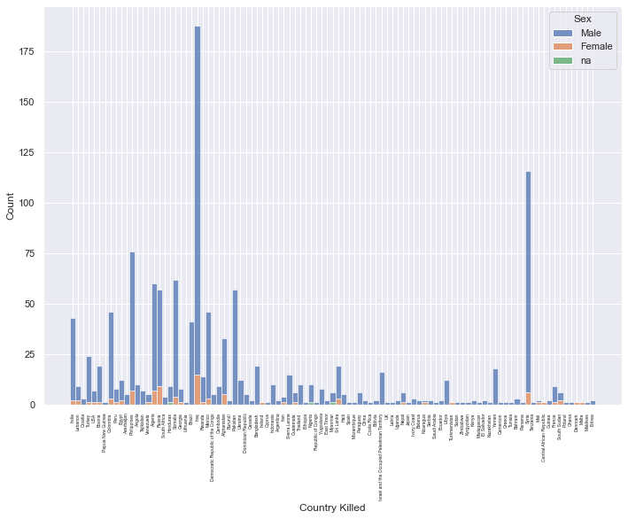
Histogram of Journalists killed based on country and sex.

Slide 8
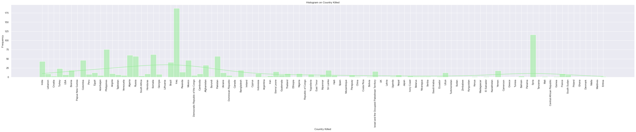
Based on Country Killed
This bar plot shows the count of journalists killed based on the country with 97 countries total.
The distribution is very unequal and concentration of journalist killings lies in a few countries only.

Slide 9
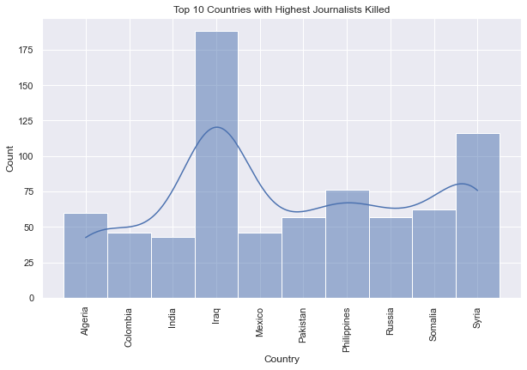
The top 10 countries are :
Algeria 60
Colombia 46
India 43
Iraq 188
Mexico 46
Pakistan 57
Philippines 76
Russia 57
Somalia 62
Syria 116
The highest deaths occur in war torn countries like Iraq and Syria.

Slide 10
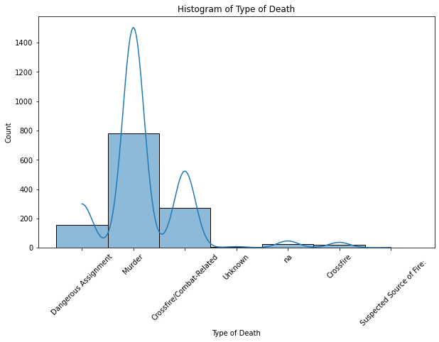
By Type of Death
Most journalists are killed either in crossfire or by murder.
This indicates that there is an intentional effort made to silence journalists rather than them getting killed in dangerous situations like war or conflicts.

Slide 11
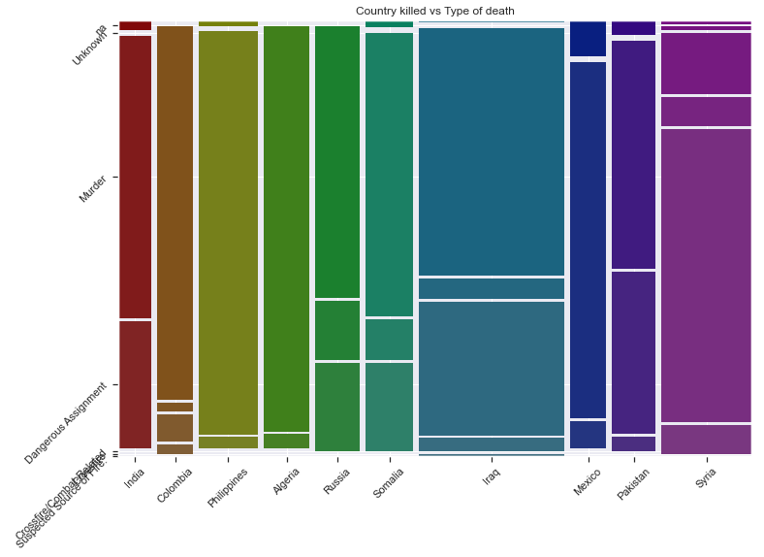
The main cause of death in certain war zones like Iraq and Syria are due to crossfire/combat-related. Reporters having dangerous assignments in Pakistan and India seem to have lost their lives very often. Murder is the most common cause of death for journalists with peaks in Algeria.

Slide 12
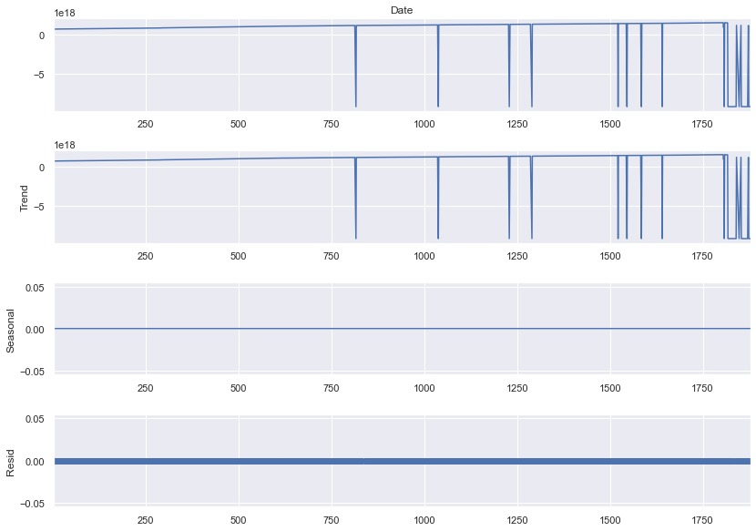
Time Series Analysis
Journalist killings have gotten more frequent and common since 2004 peaking from 2007-2012. The reasons for this increase can be:
An increase in online journalism leading to an increase in the reach of news across the world
Wars and conflicts in certain regions like Iraq War, Gaza War, Syrian Civil War, etc
An increase in dangerous assignments in such conflict regions have put investigative journalists in very risky and precarious situations where many of them tend to lose their lives.

Slide 13
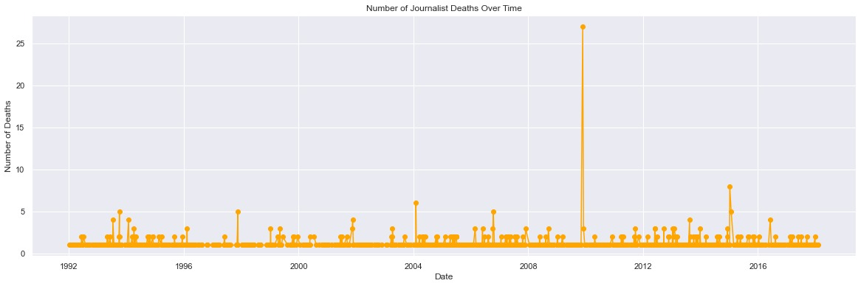

Slide 14
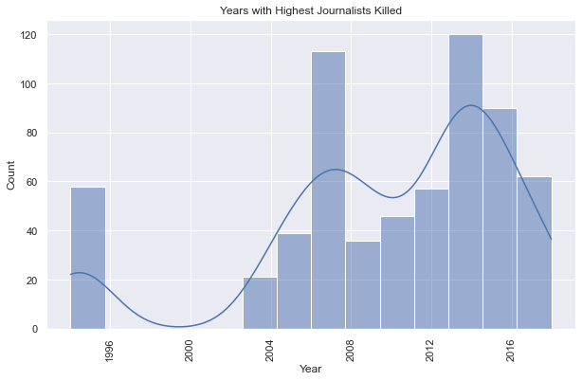
The years with the highest journalists deaths are:
1994 58
2004 60
2006 57
2007 68
2009 70
2012 74
2013 72
2014 56
2015 65
2017 62
dtype: int64

Slide 15
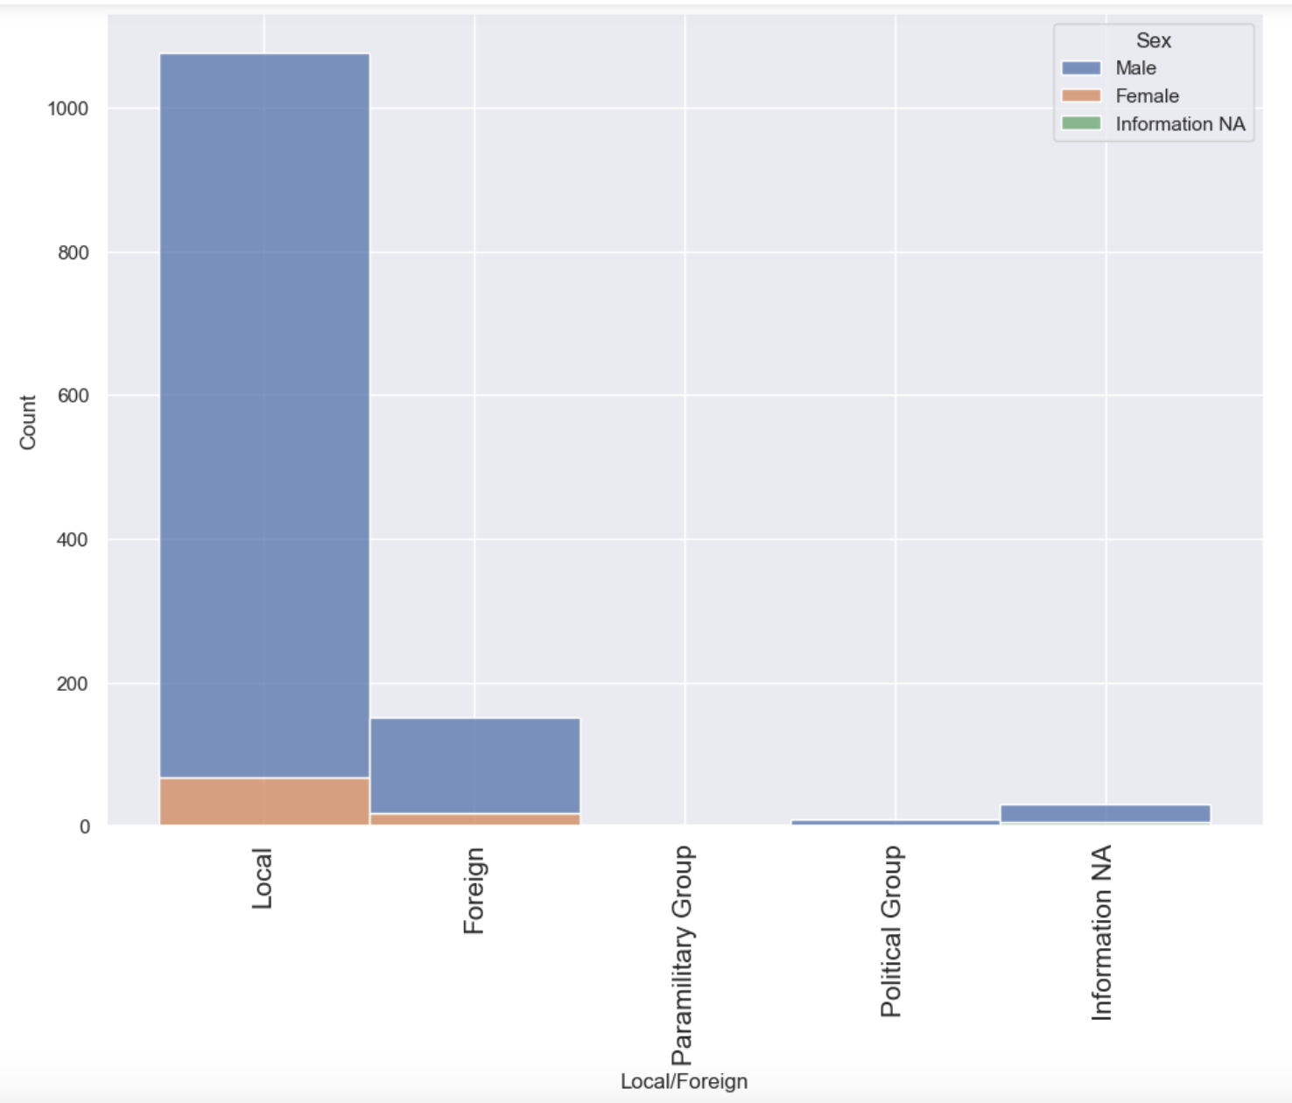
Victim Demographics:
By sex and if the journalists were local or foreign:
The bar graph depicts the gender and nationality of journalists killed since 1992. It reveals that local male journalists constitute the majority of those killed, indicating a high risk for this group. Foreign male journalists also face dangers, but not to the same extent. Female journalists, both local and foreign, represent a significantly smaller proportion of those killed, possibly due to fewer women in high-risk roles.

Slide 16
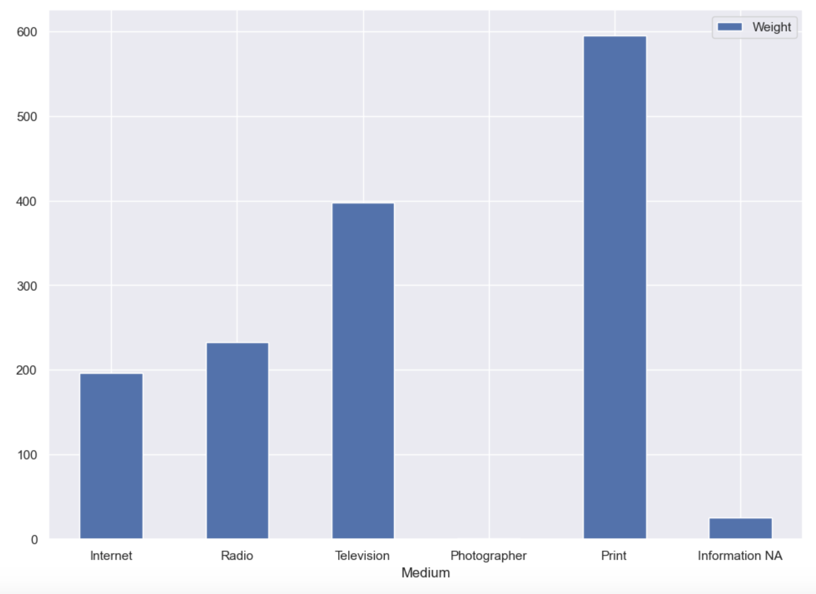
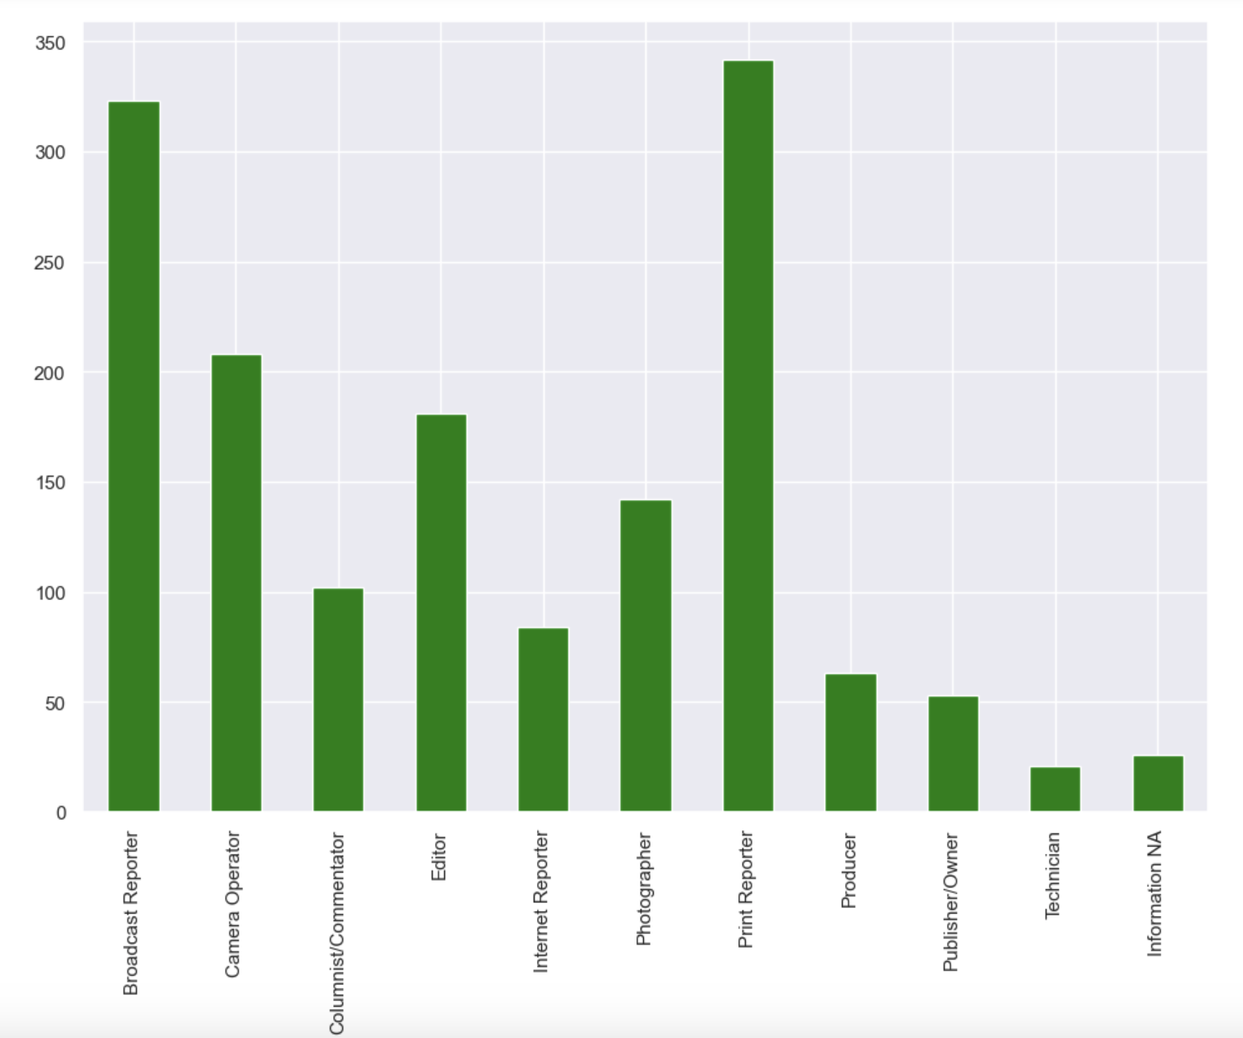
The bar plot provides a stark representation of the risks faced by journalists across different mediums. The highest number of journalists killed were those working in print media, indicating that traditional forms of journalism carry significant risks. This is followed by television and radio, which also have considerable numbers. Interestingly, the internet media has the lowest number of journalists killed, suggesting that digital platforms might offer a safer environment for journalists.
The highest number of fatalities are among Broadcast Reporters, highlighting the dangers faced by those who report news live from the field. This is followed by Columnists/Commentators and Editors, indicating that those involved in the production and dissemination of news content are also at significant risk.

Slide 17
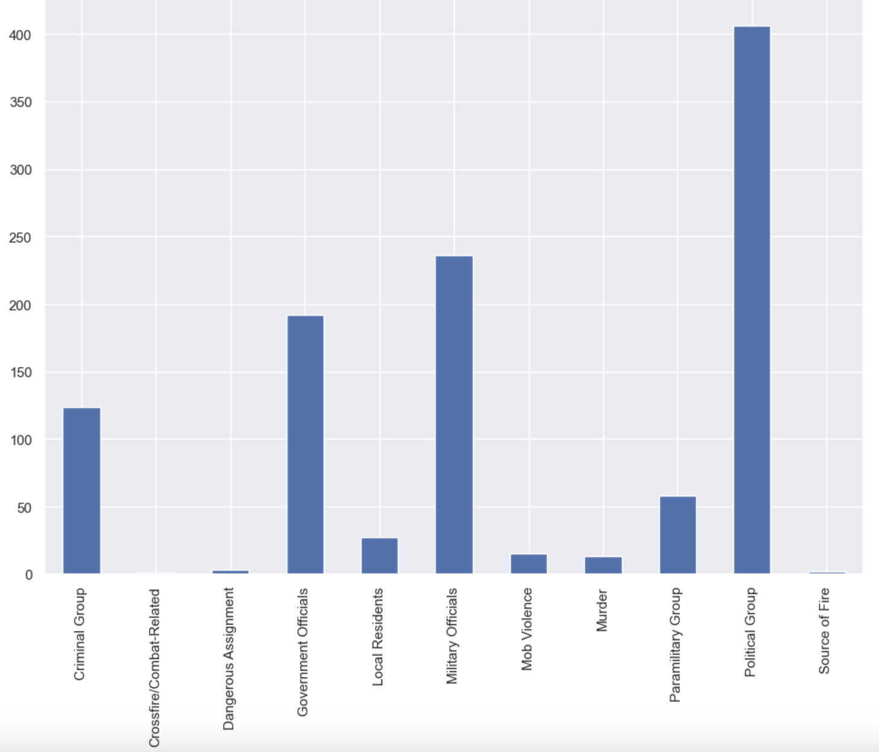
Source of Fire:

Slide 18
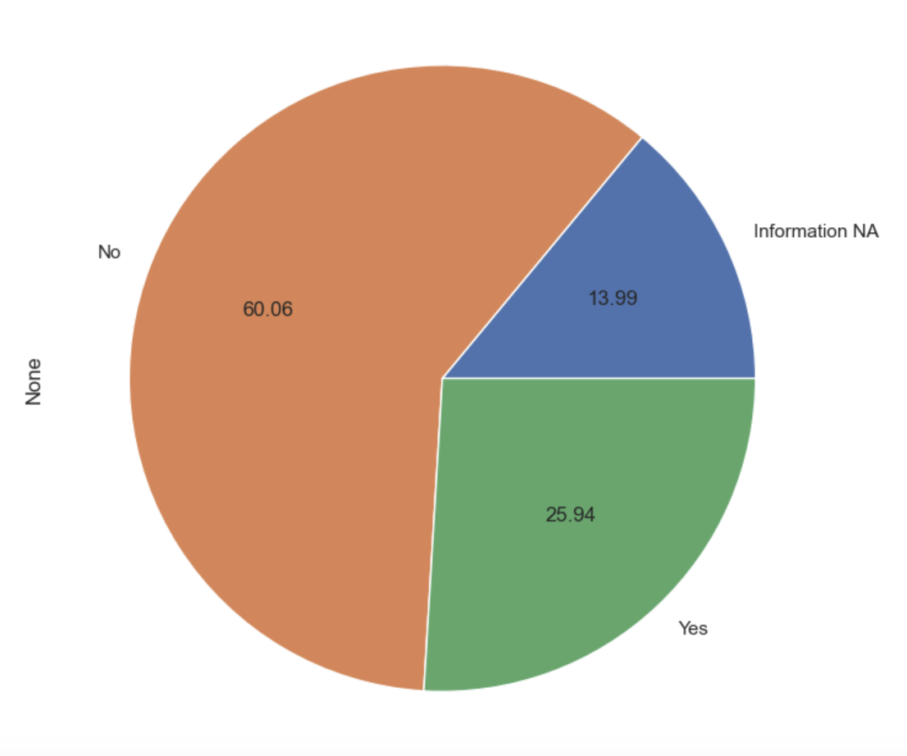
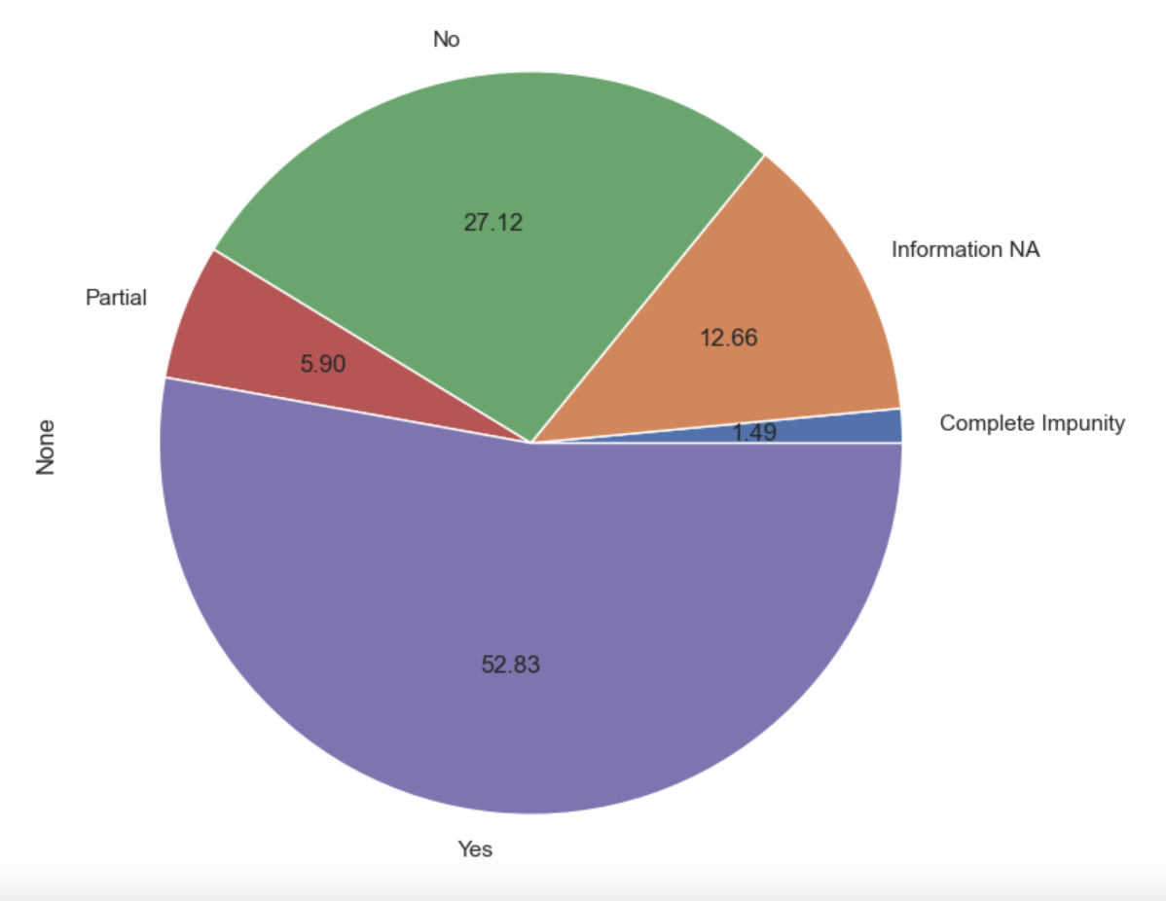
Additional factors: Threatened, Impunity for Murder, Held Captive and Tortured:
Threatened
Impunity

Slide 19
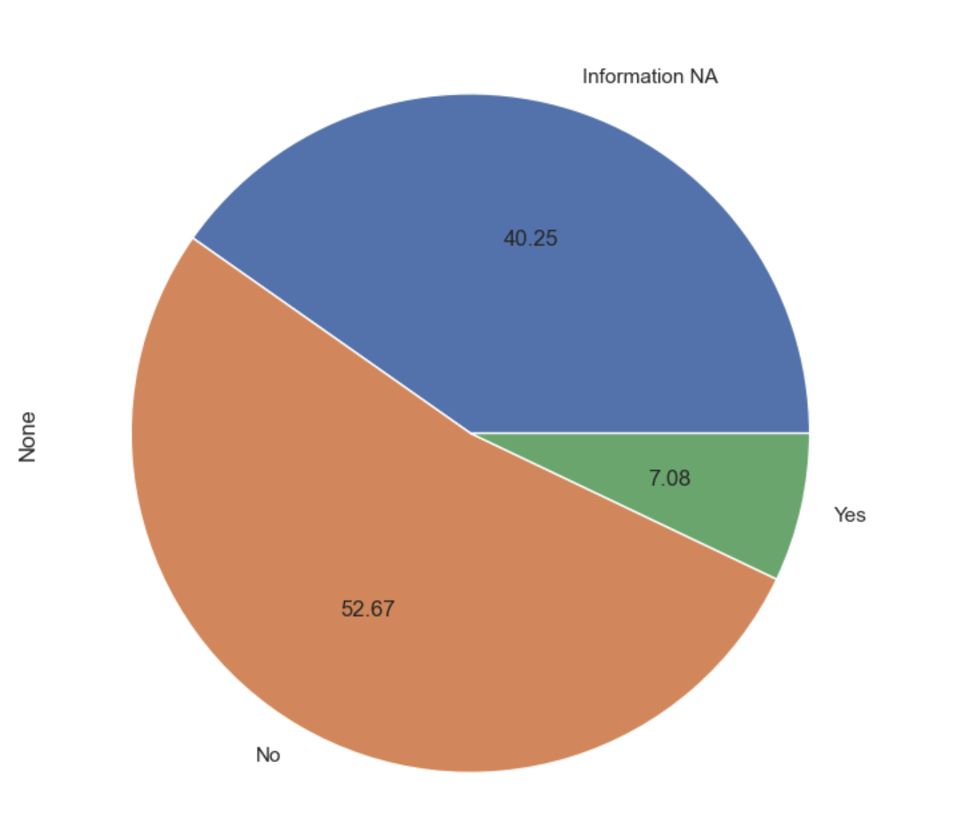
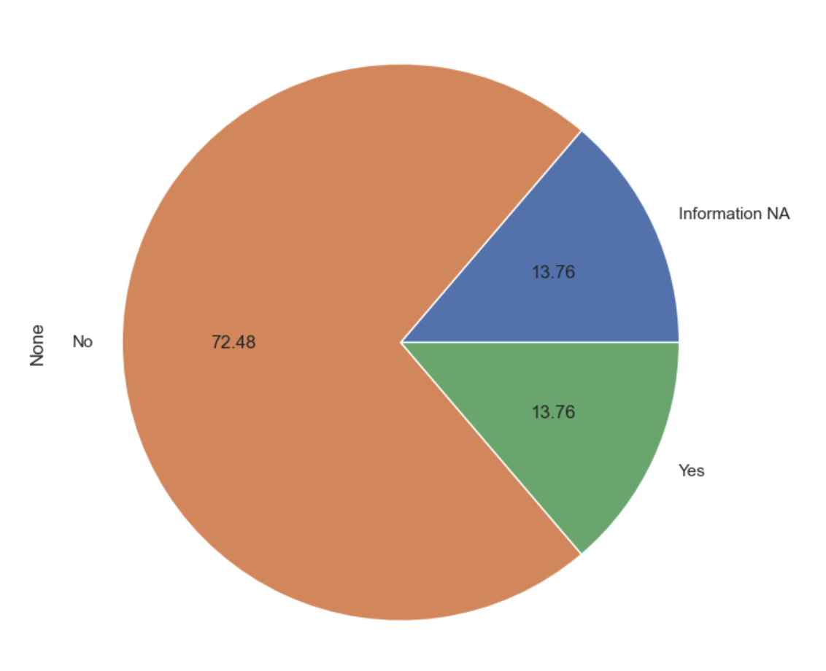
Tortured
Taken Captive

Slide 20
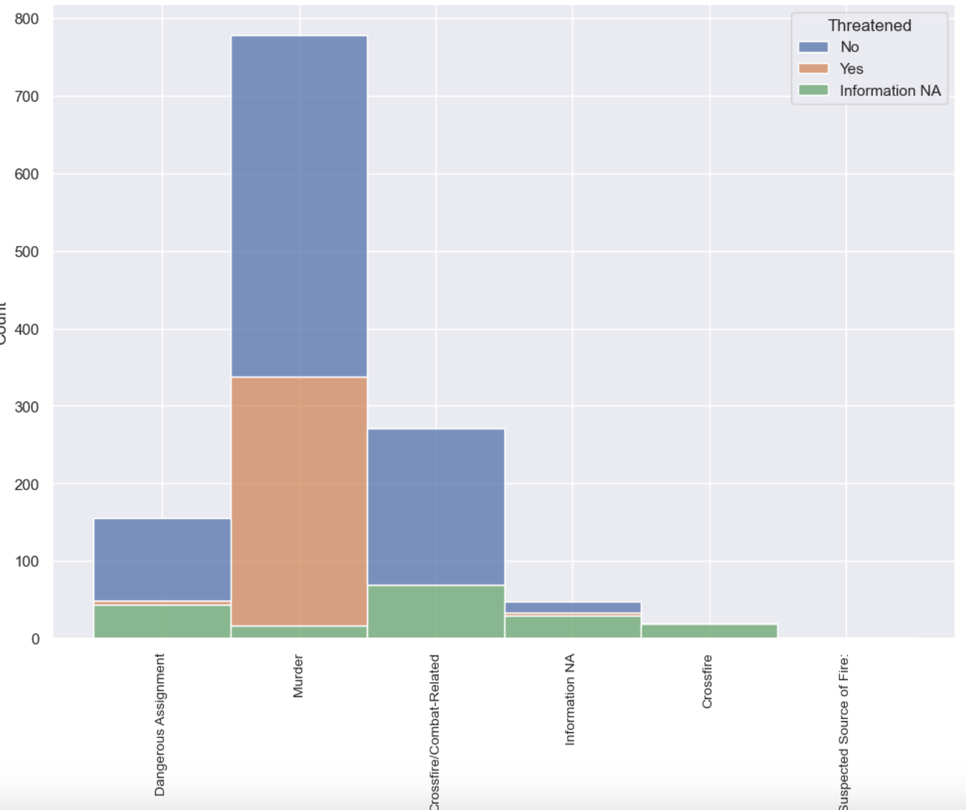
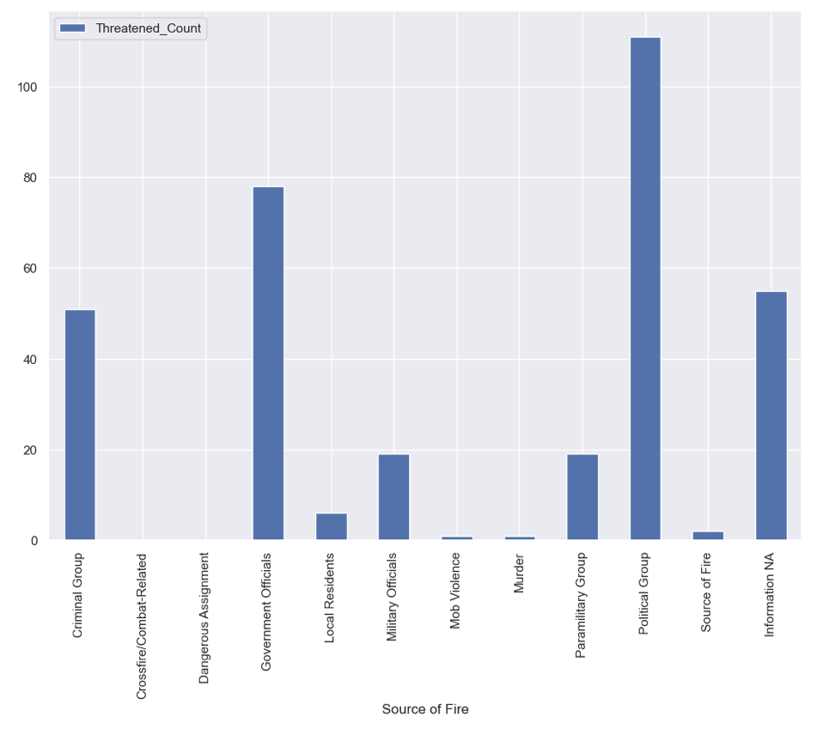
Information about threatened journalists:

Slide 21
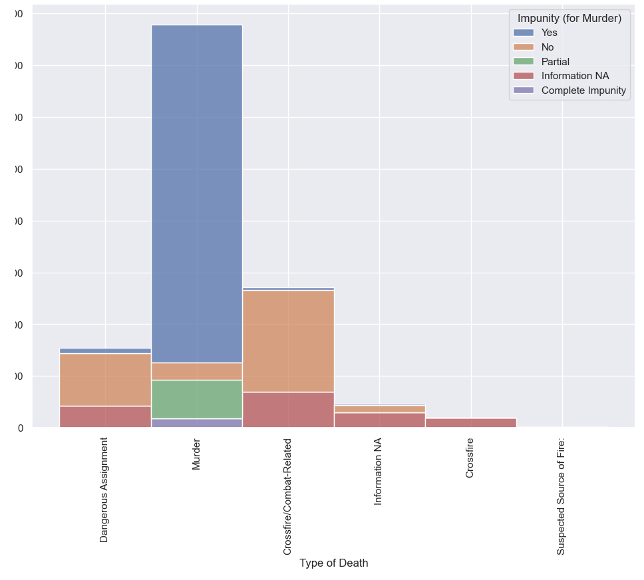
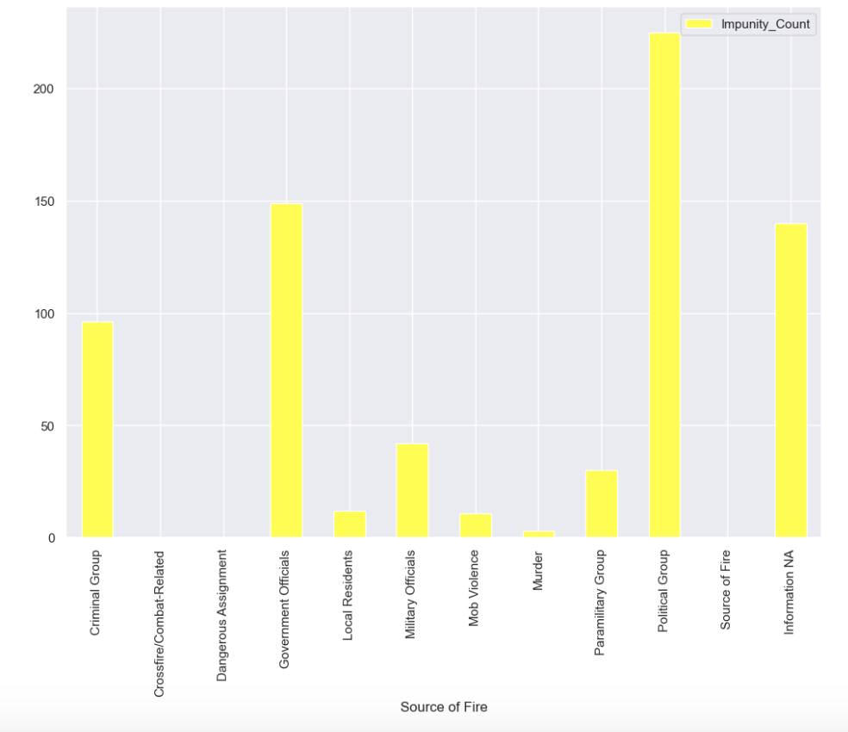
Information about Impunity granted for assassinations:

Slide 22
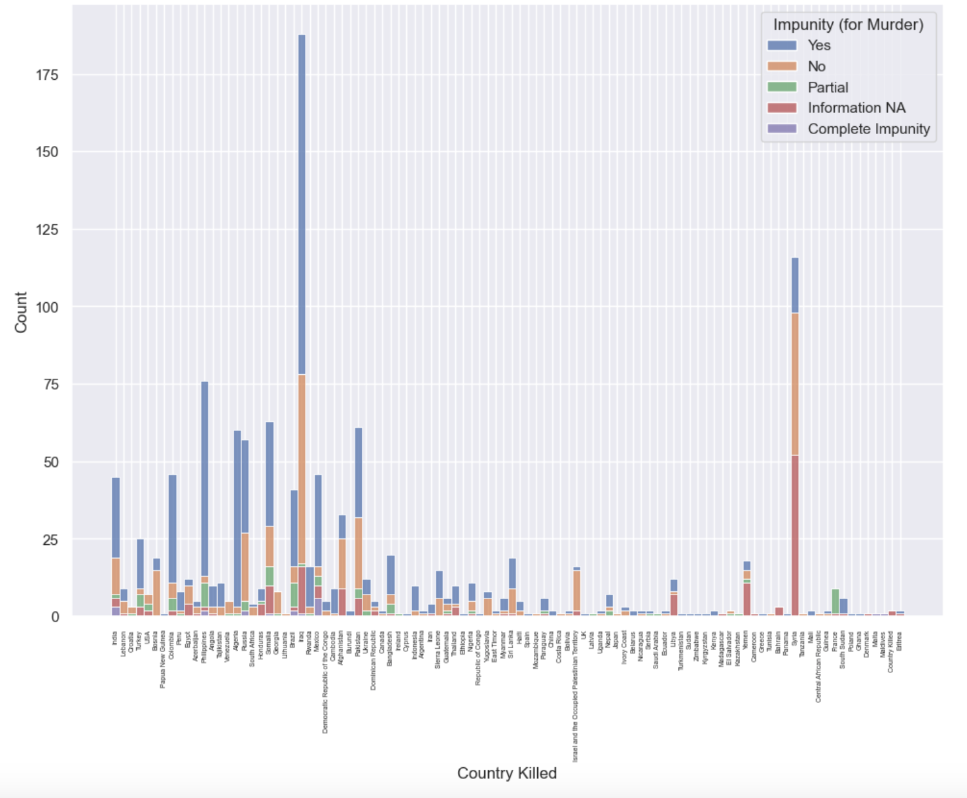

Slide 23
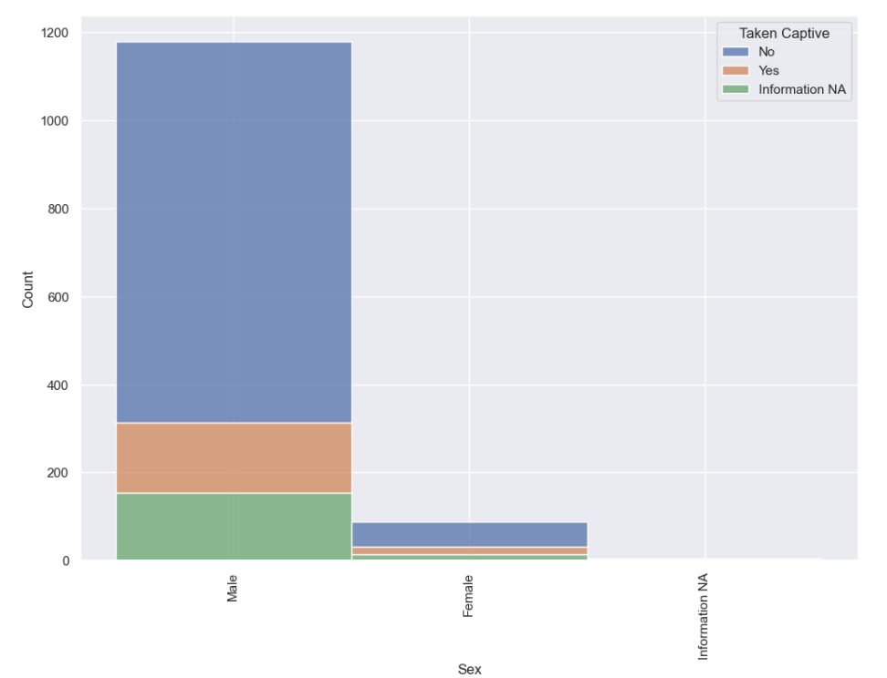
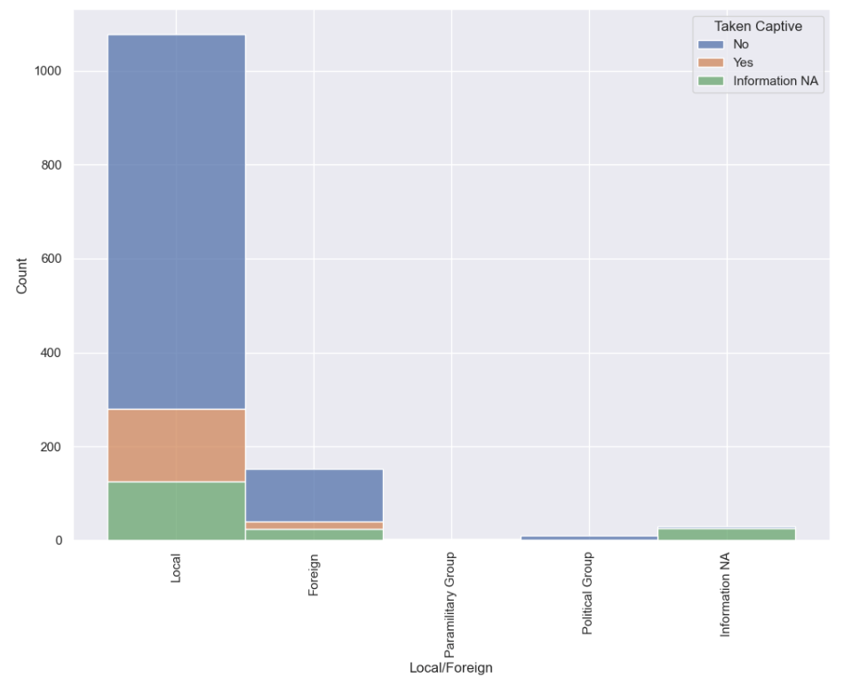
Information about journalists held captive:

